Slide 1
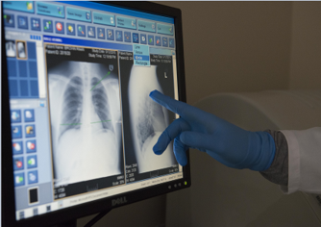
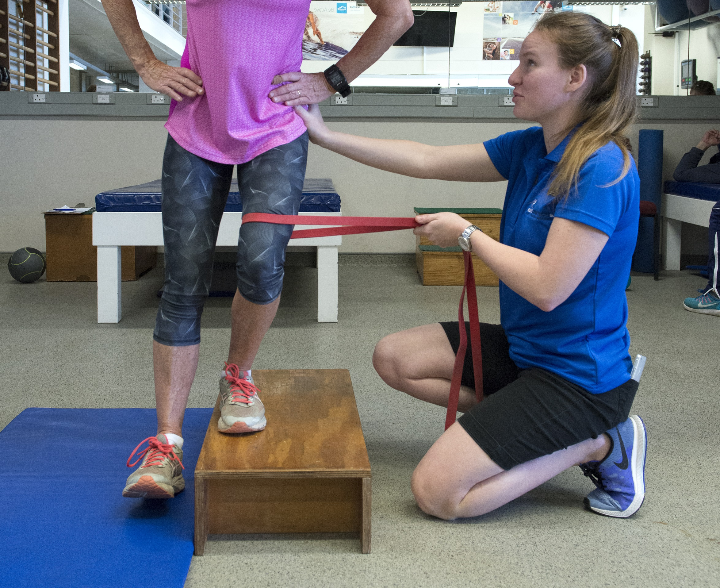
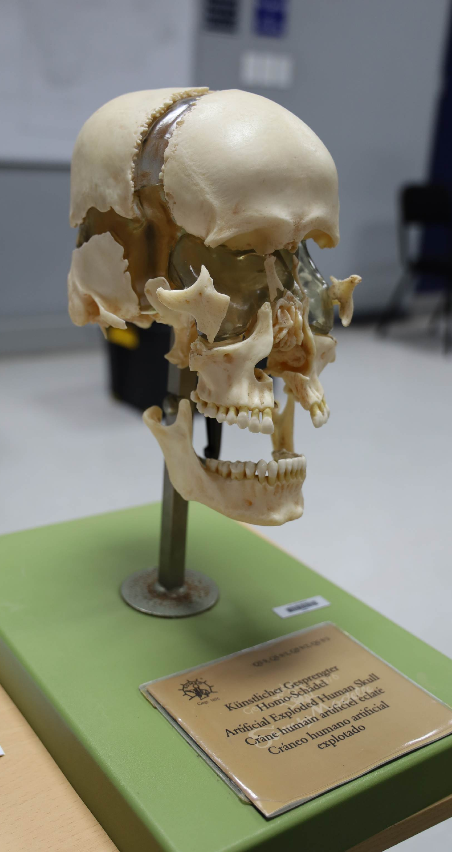
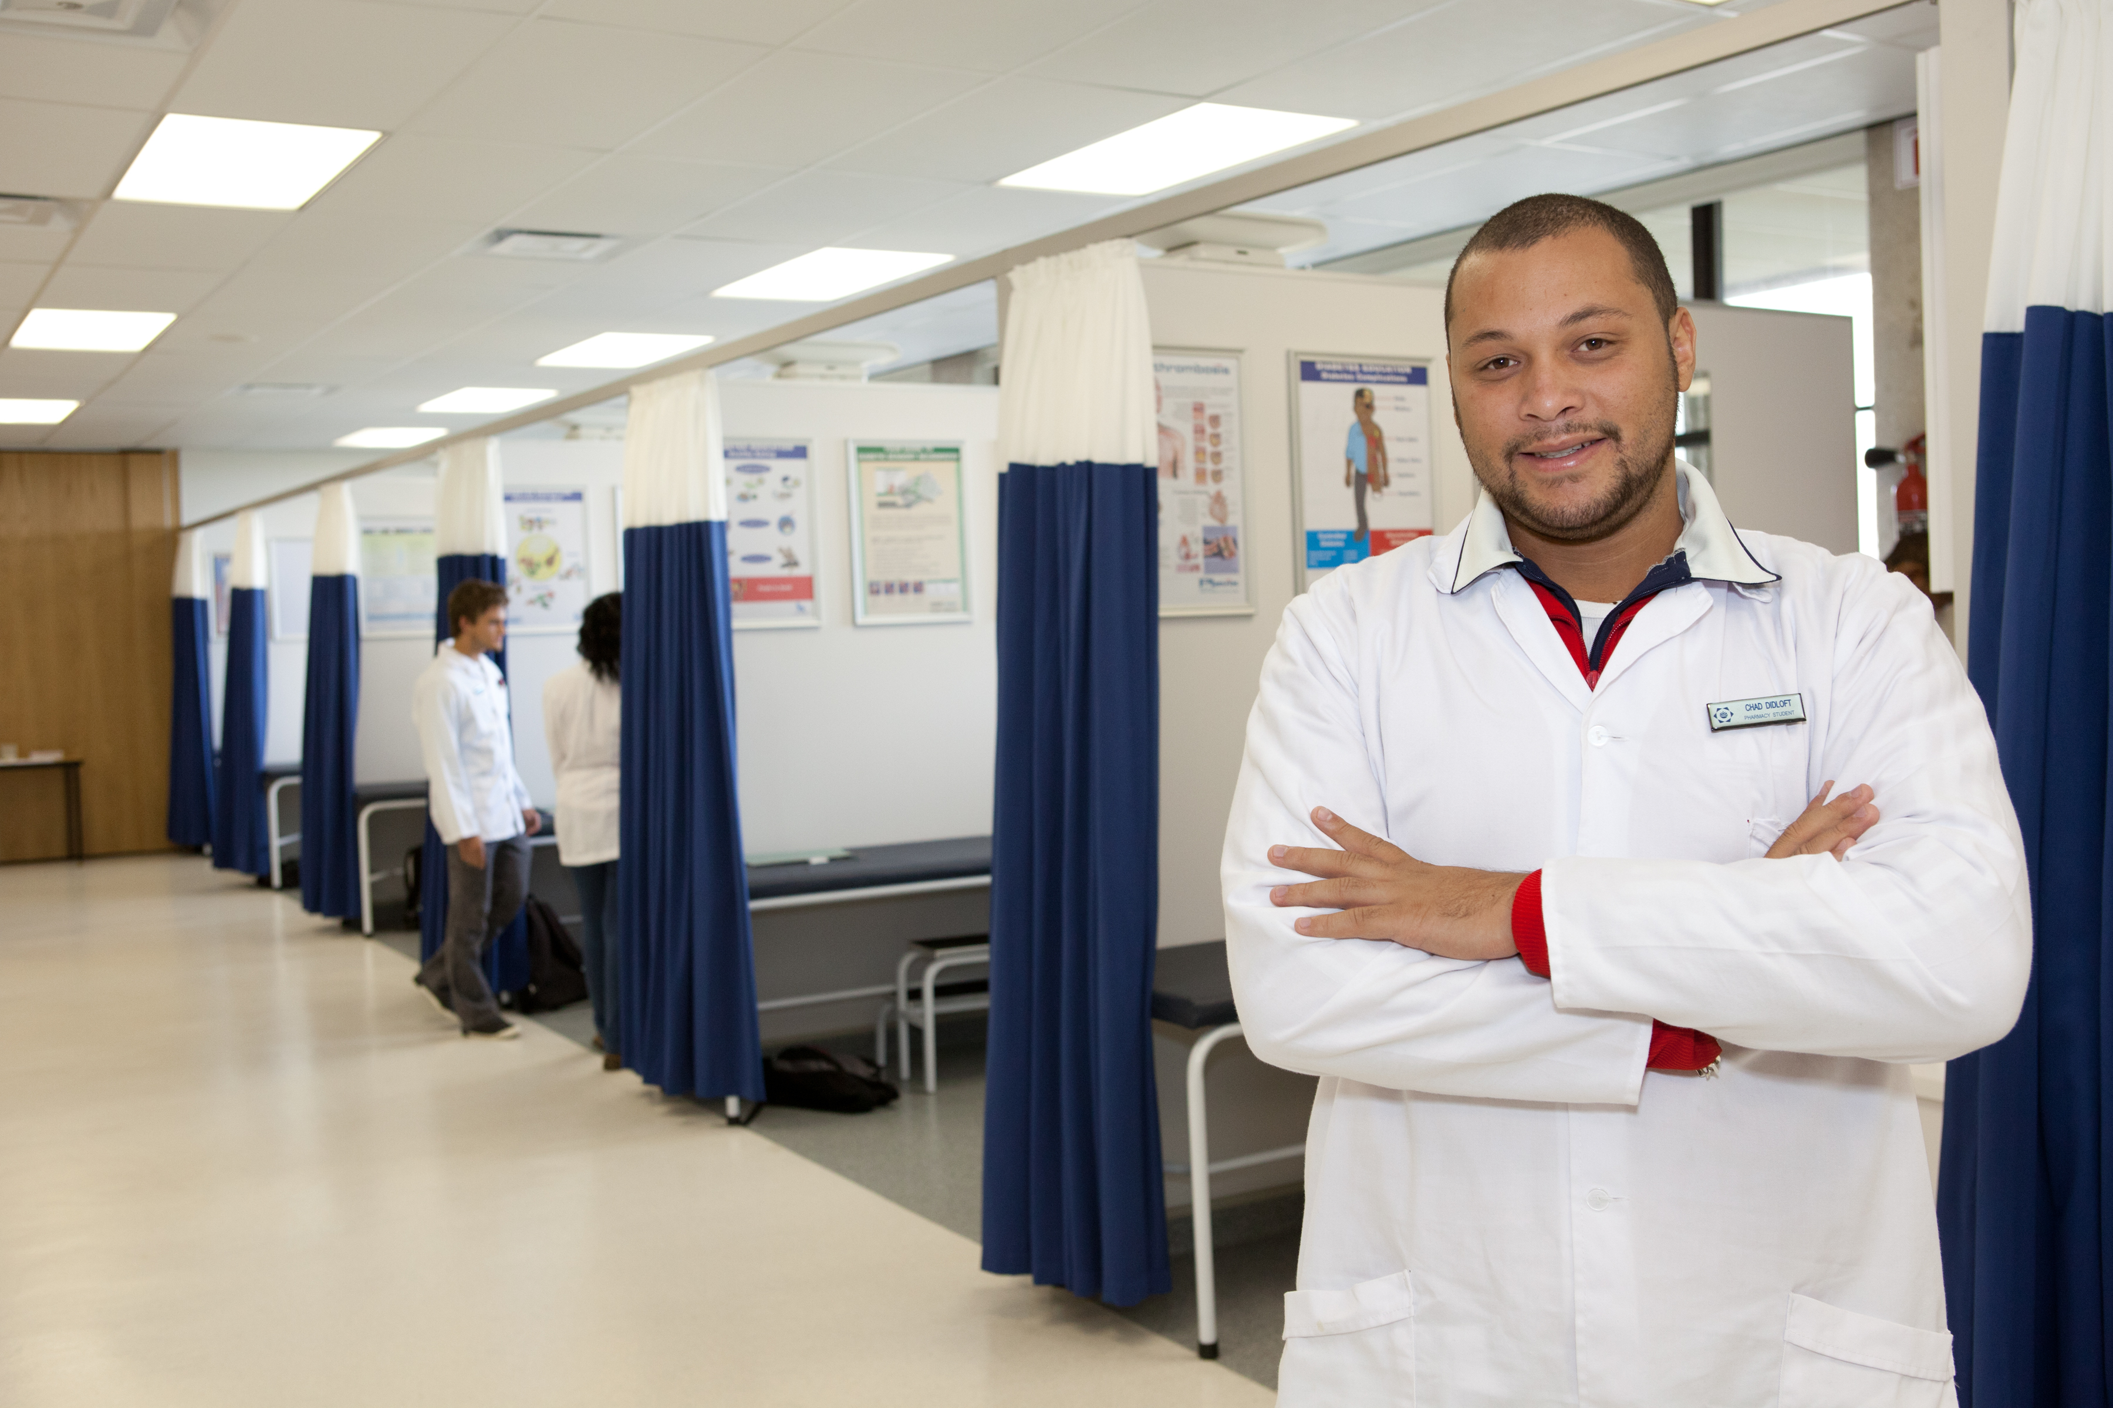
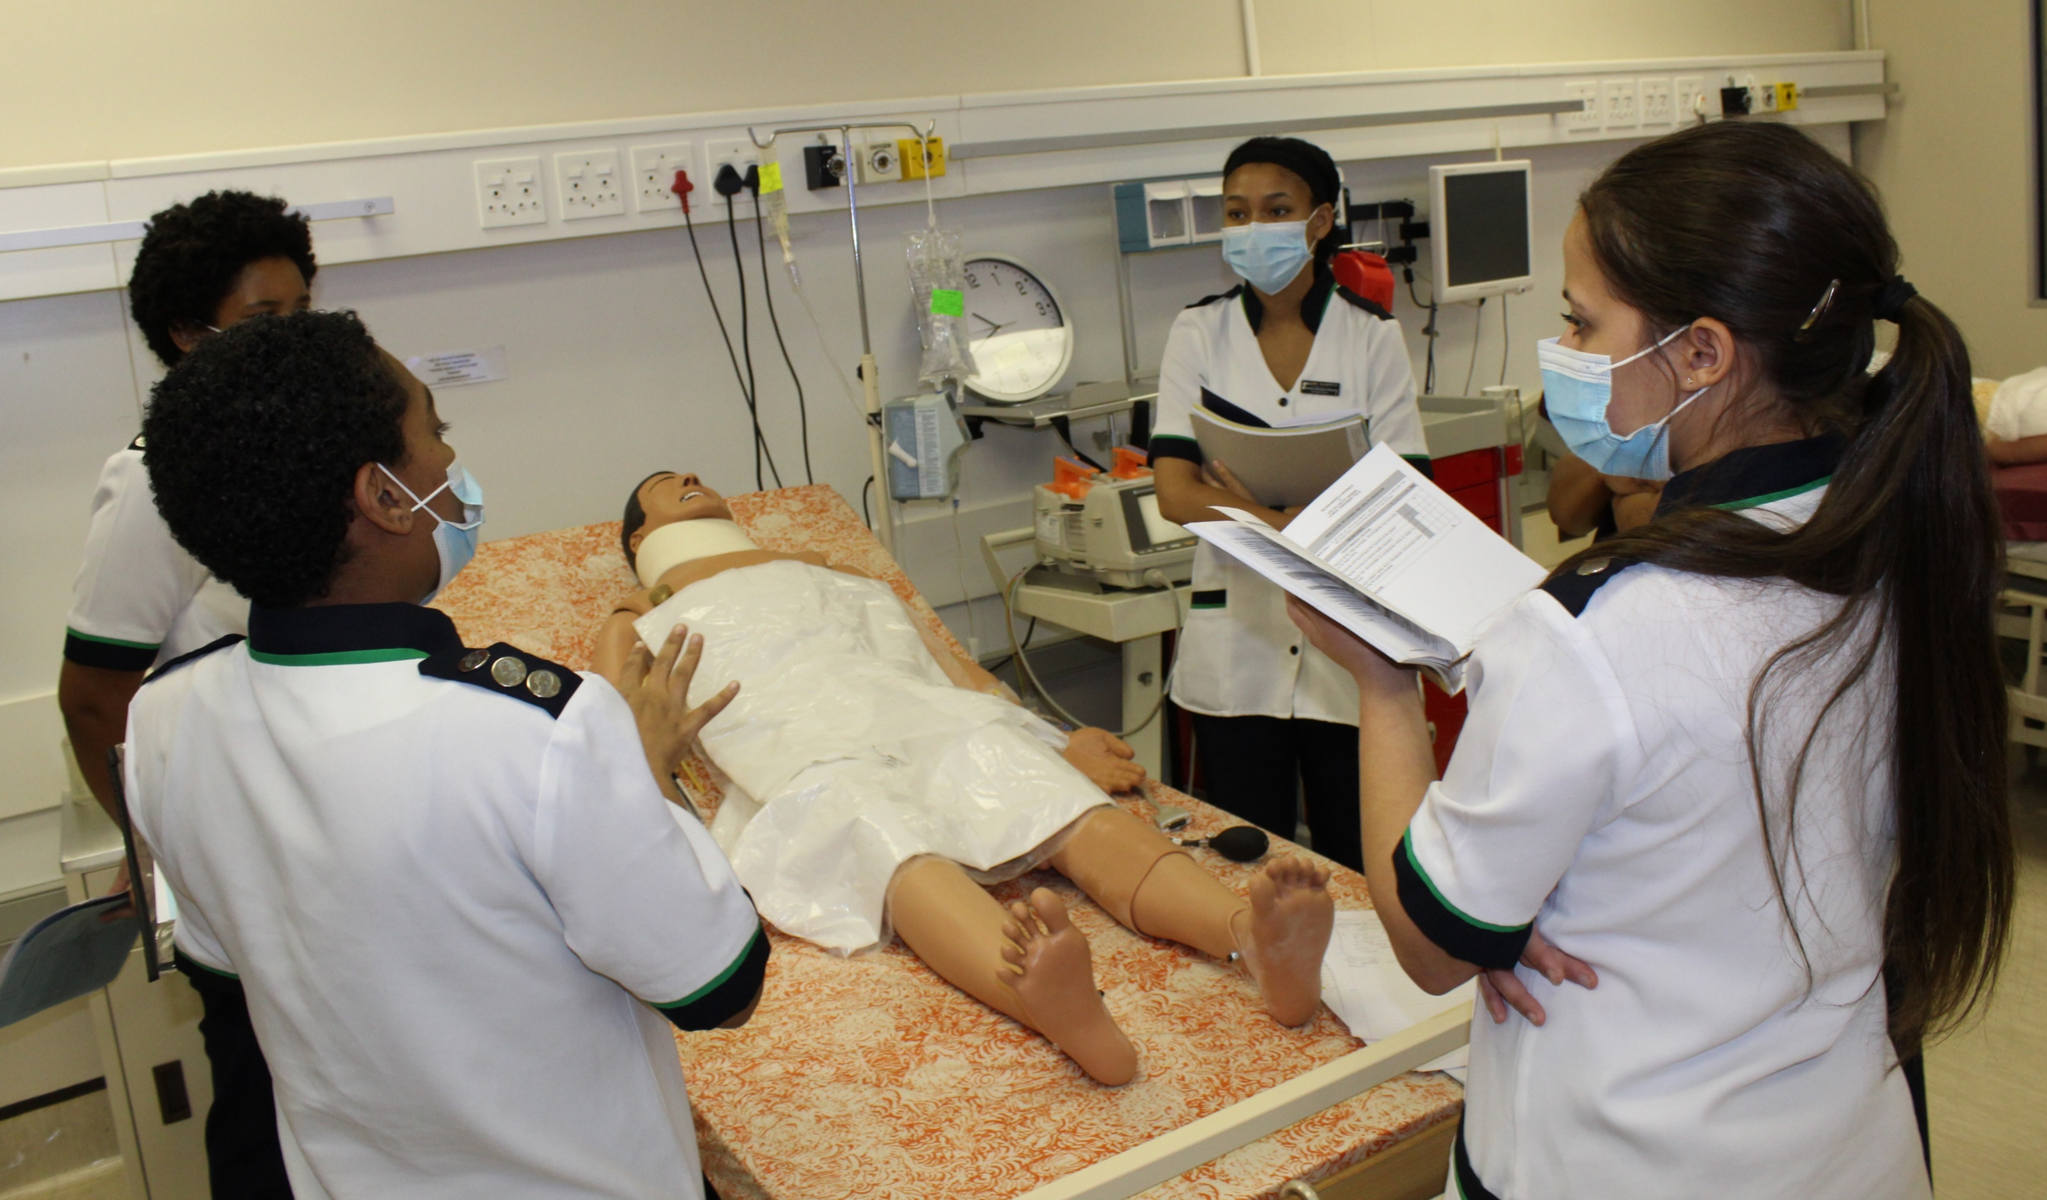
HEALTH SCIENCE RESEARCH DIRECTORATE
Masters and PhD degree planning.

Slide 2
M& D Matters: Registration
Registration
Deviations
Masters
3yrs Fulltime
4yrs Part time
PhD
4yrs Fulltime
6yrs Part time
You can change registration type
Lapsed registration: Considered as part of max prescribed period
One academic year
Abeyance/break in studies
Extension of studies

Slide 3
M&D Matters: Submission of Proposal
Masters via research
Masters Coursework
6 months of registration of treatise module
PhD
6 months after registration
12 Months of registration

Slide 4
Postgraduate studies relationship
Stakeholders
Supervision relation
Monitoring
FPGSC
Research team
Departmental research coordinators
Supervision agreement
Resignation/retirement of supervisor
Change of supervisor
Progress reports

Slide 5
Examination Process
Submission Process
3 Months before:
Intention to submit
Appointment of examiner
During:
Permission to submit for assessment
Turnitin report
After:
Communication of exam outcome
Permission to submit final copies

